Slide 1
models
A simple approach to complex problems

Slide 2
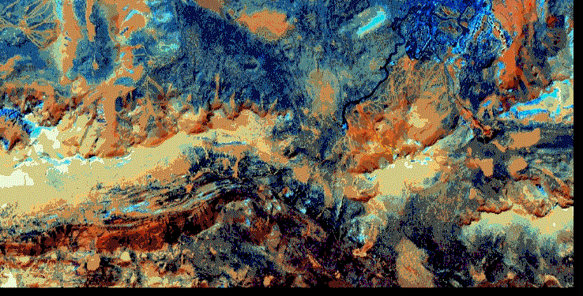
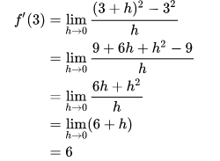
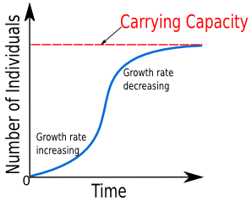
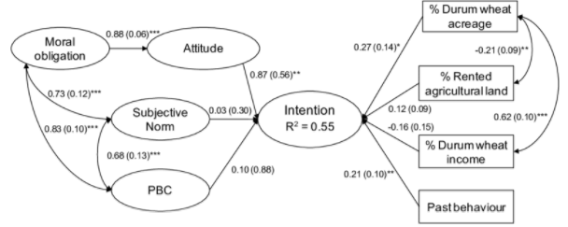
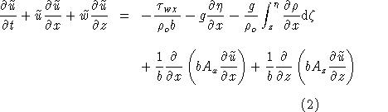
Overview
What is an “ecological model”?
Types of models & how agent-based models are different
General notes on modeling
Overview of the modeling process

Slide 3
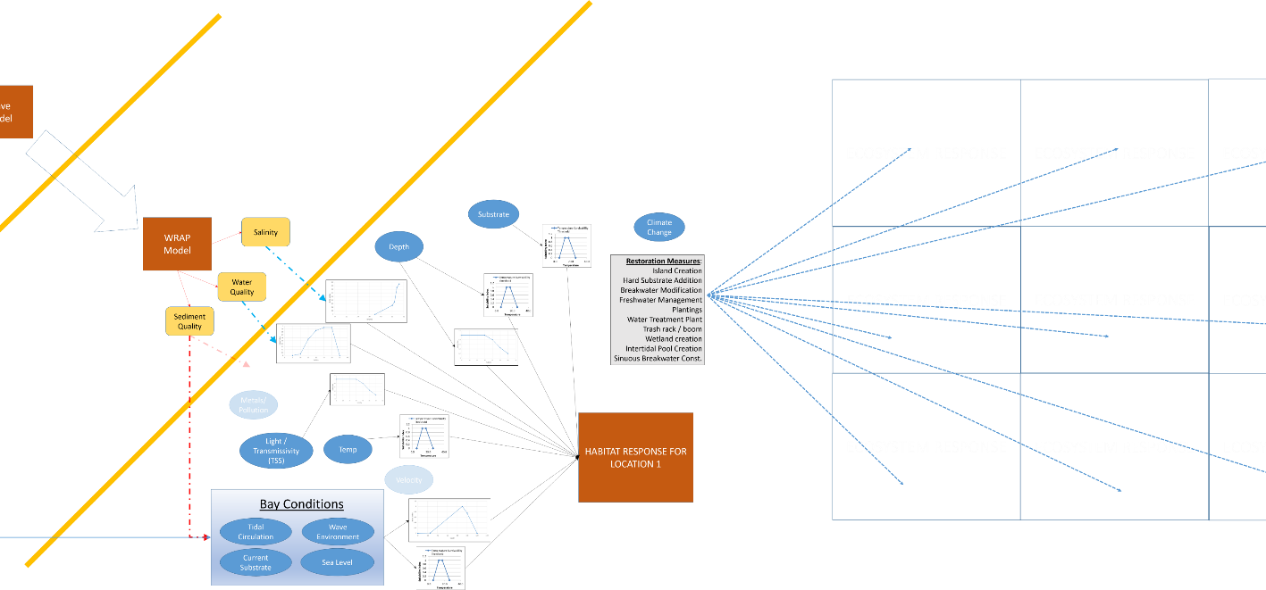
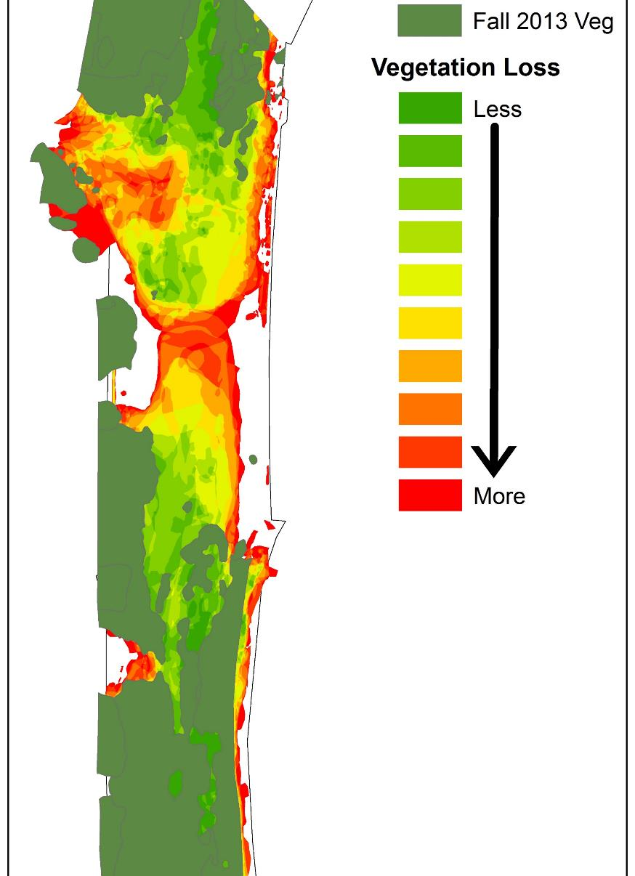
Definition of models
You are a modeler.
Commonly used in the nerd world:
“abstractions of reality”
“a representation of a system for a purpose”
“a way to represent a system for the purposes of reproducing, simplifying, analyzing, or understanding it”
How would you tell your family what a model is?

Slide 4
Definition of model for this class
Numerical representation of an ecological system implemented in software
SIDE NOTE: not software applicable to any situation

Slide 5
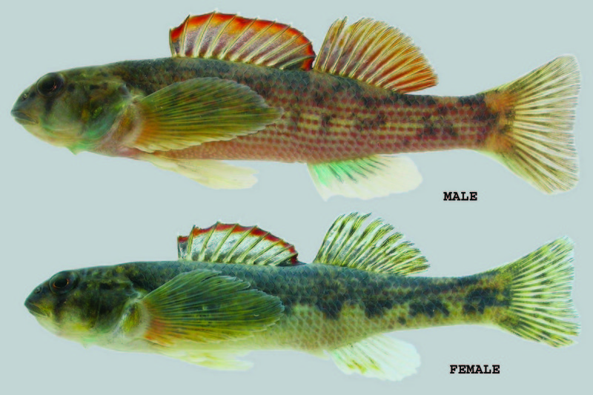
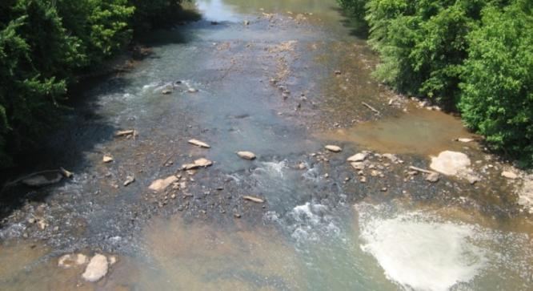
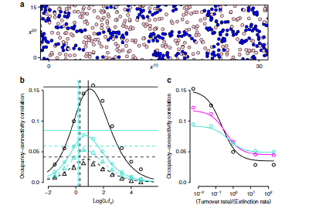
Ecological modeling
Represents environment based on point of view of model builders
Ecology is a question-driven discipline
Ecosystems are inherently complex, interdependent systems with lots of uncertainty
Models are developed to explore complexity, interactions, forecasts
Each species reacts differently to stimuli
Multiple approaches for a single problem
Habitat v. population v. meta-population v. community v. ecosystem
Different types of models can be used for same question
Trade-offs: detail, scale, expense

Slide 6
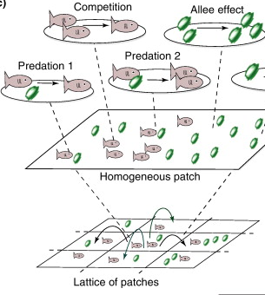
Why do we develop models?
Models!
To increase understanding & develop theory
To organize thinking
To forecast future conditions
To inform decision-making
Provide a platform for critical thinking

Slide 7
Is modeling science?
Is science modeling?
Modeling process is based on scientific method
A hypothesis is a mental/written model
Odum (1984) describes models as an important part of scientific method
Software has made it easy to ignore scientific practice
Standard techniques and documentation are important for scientific models
Iterative model
development

Slide 8
Ecological Modeling Approaches
Ecological Question | Example Modeling Approaches
Where might species X be found? | Habitat suitability index (HSI), GIS-based regression
How will climate change affect species X? | Individual (agent) , HSI modeling
Will species X persist in region Y with habitat fragmentation? | GIS, Metapopulation, Agent-based
How rapidly will species X invade area Y? | Agent-based ,GIS, System dynamics
How will disease X spread through species Y? | Demographic, Agent-based, GIS
How will pollutant M affect species X? | Biochemical model, statistical analysis of experimental data
How much timber can be harvested | Forest growth model
How can we control pest species X? | HSI, Agent-based, System dynamics

Slide 9
Engineering v. Ecological Models (Part 1)
 | Engineering Models | Ecological Models
Primary Basis | Physics Chemistry (water quality) | Physics Chemistry Biology INTERACTIONS THEREOF
First principles? | Sometimes (e.g., Laws of Motion) | Rare / Never (Often do not exist)
Knowledge of dynamics | High | Low
Model Confidence | High | Low
Science/Art | 90/10 | 25/75

Slide 10
Engineering v. Ecological Models (Part 2)
Engineering Models | Ecological Models
Models are well developed and reusable | Most models are single-use
New application uses old models | New application uses new models
A small set of models is sufficient | A toolbox containing a dozen modeling approaches is required
The model components are well understood | Most ecological systems are poorly understood
Models are used for prediction | Models are used for exploration and education
Models are heavily science-based | Models rely on local expertise

Slide 11
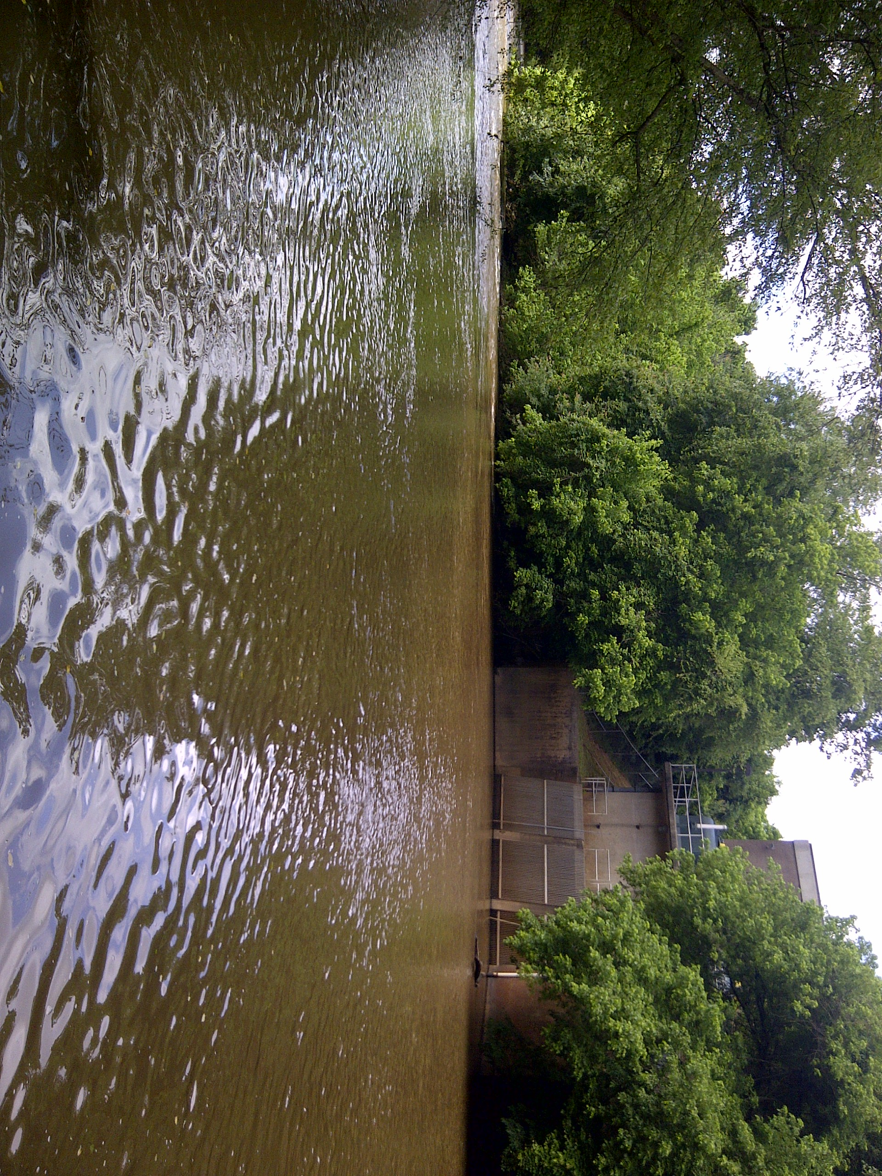
Models are never
Answers or Decisions
People make decisions. Models inform people.
Reality
Inherently a model is an abstraction of reality.
X

Slide 12
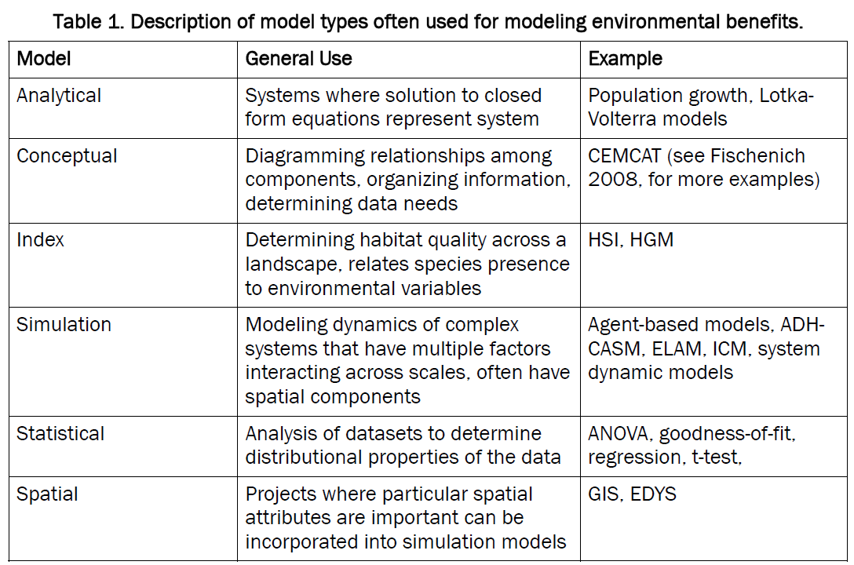

Slide 13
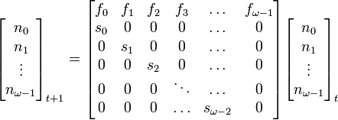
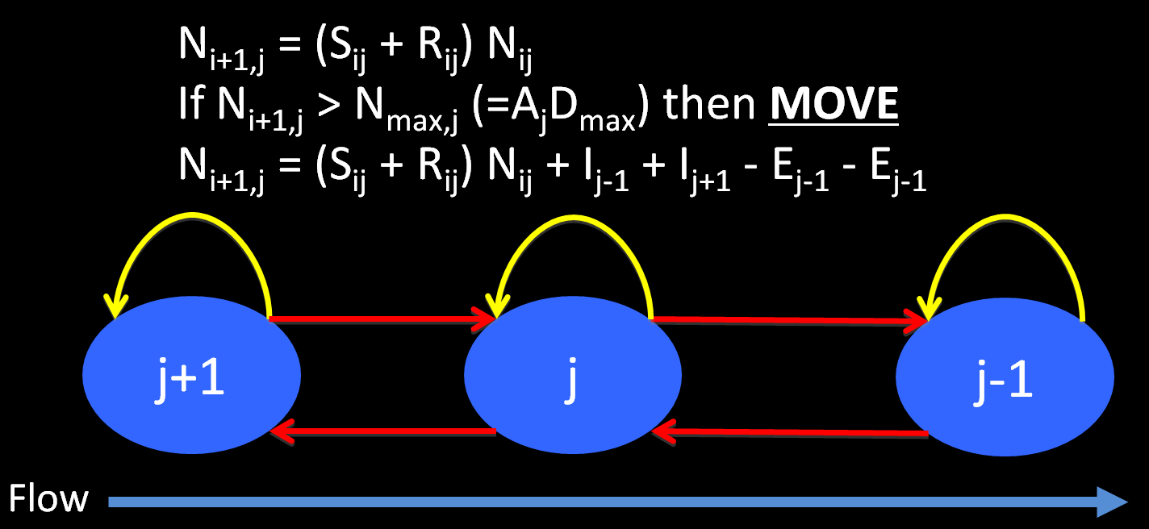
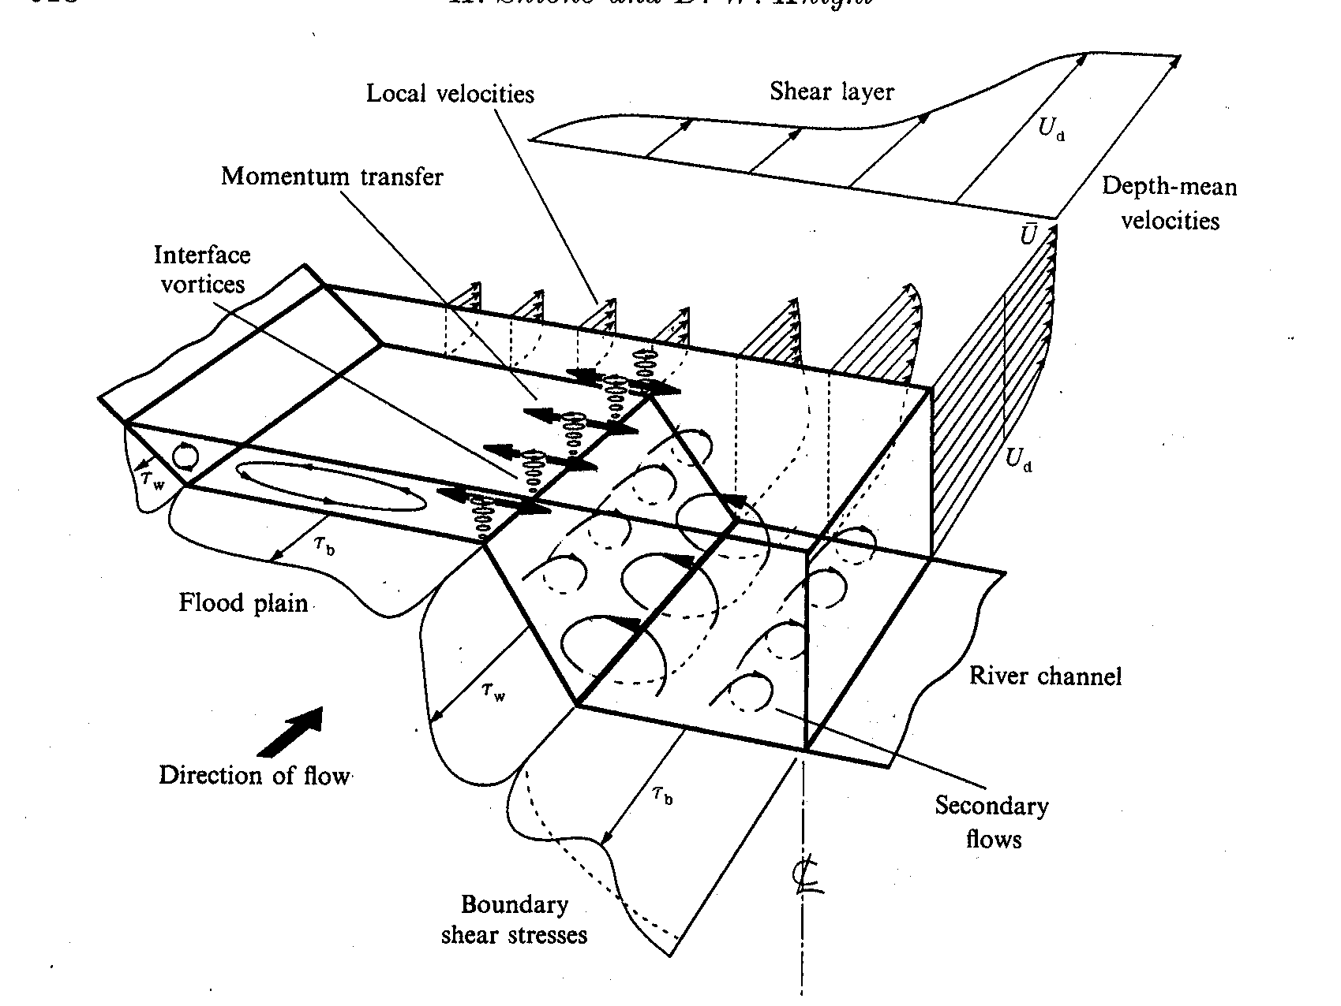
Analytical Models
Solution of closed form equations representing the system

Slide 14
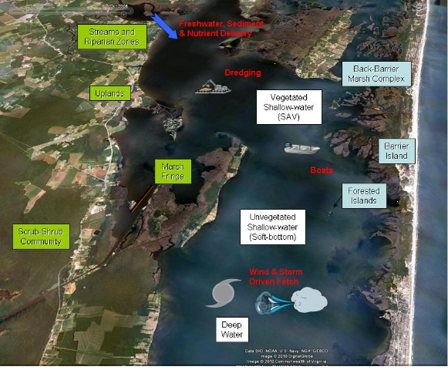
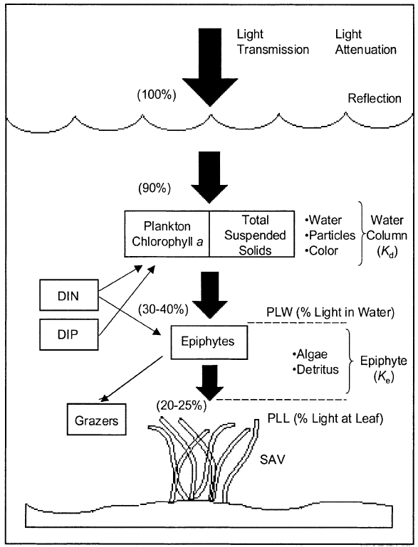
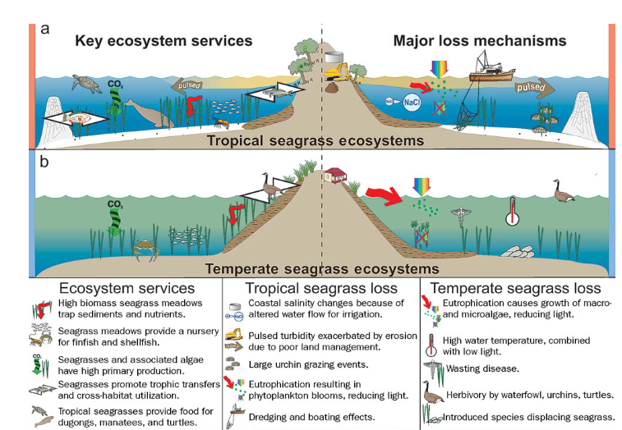
Conceptual Models
Diagramming relationships among components, organizing information, determining data needs

Slide 15
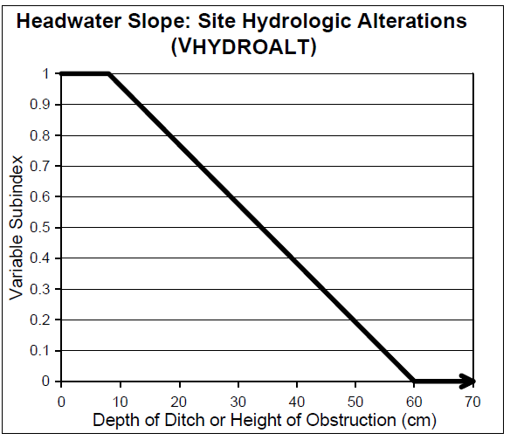
Index Models
Determining ecosystem quality relative to environmental variables
Quantity * Quality
Quality for what?
Species – HSI
Community – HSI
Function – HGM

Slide 16
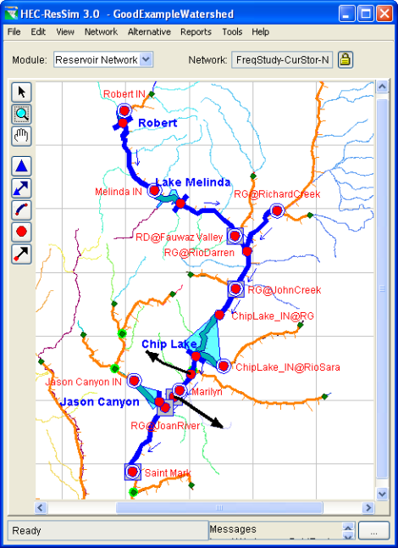
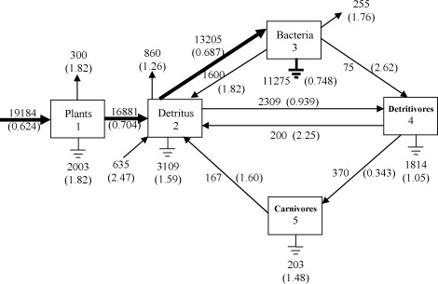
System Dynamics
Modeling dynamics of complex systems by focusing on state of system as summarized variables (e.g., overall biomass, population size, etc)

Slide 17
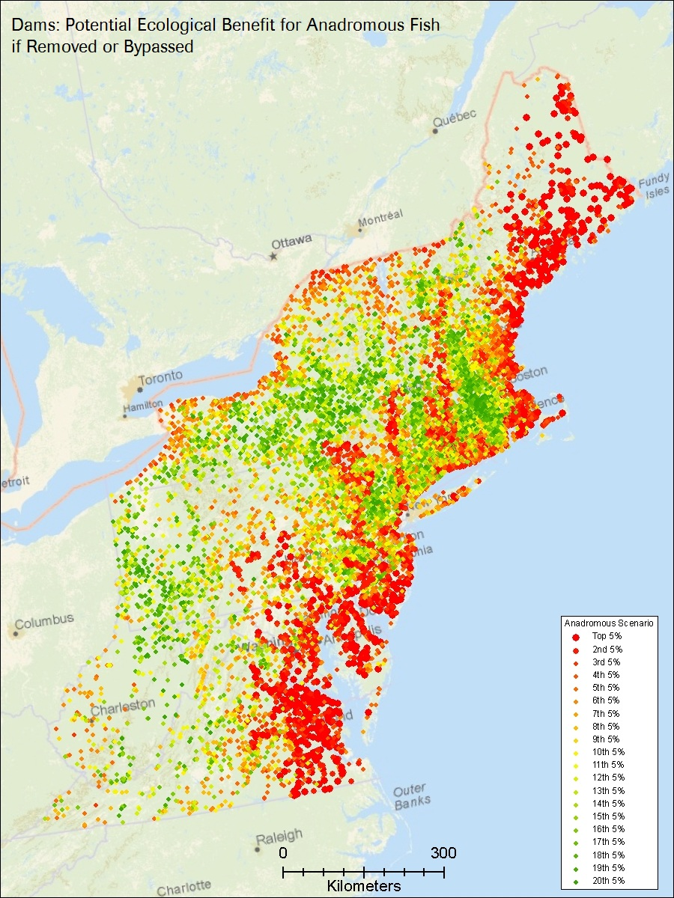
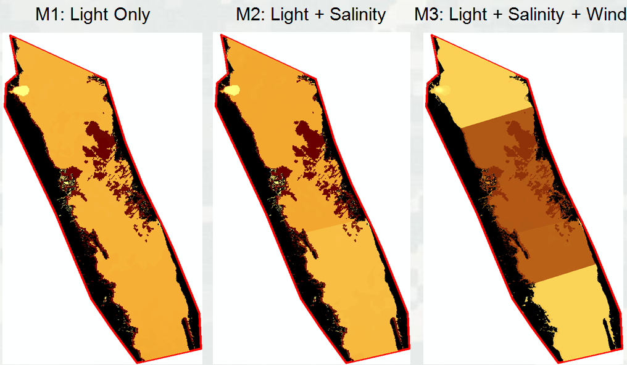
Spatial Models
Combination of spatial attributes often coupled with simulation

Slide 18
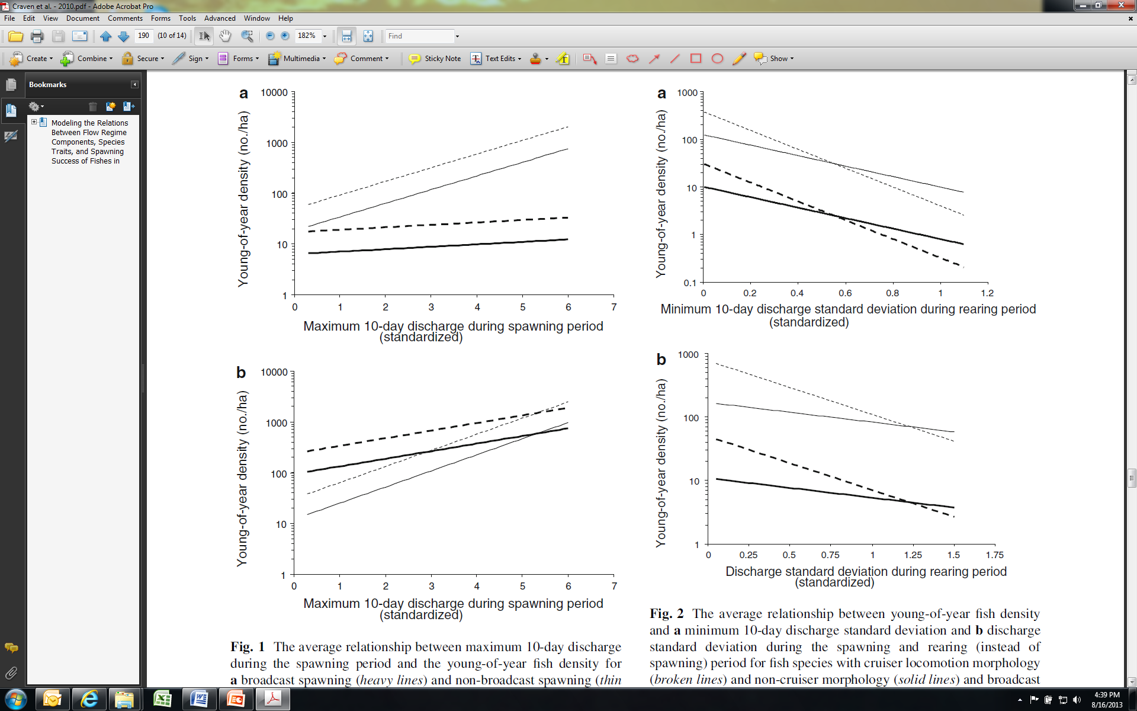
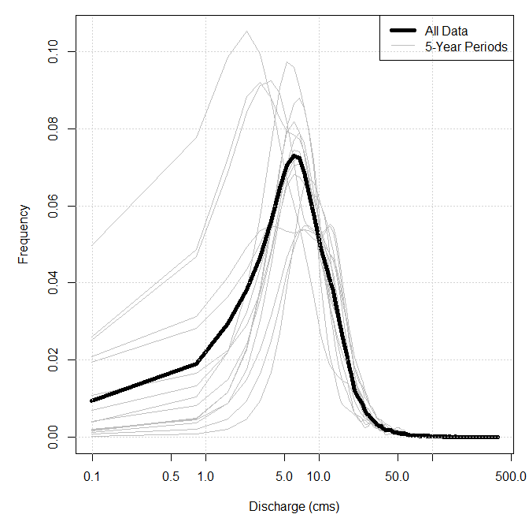
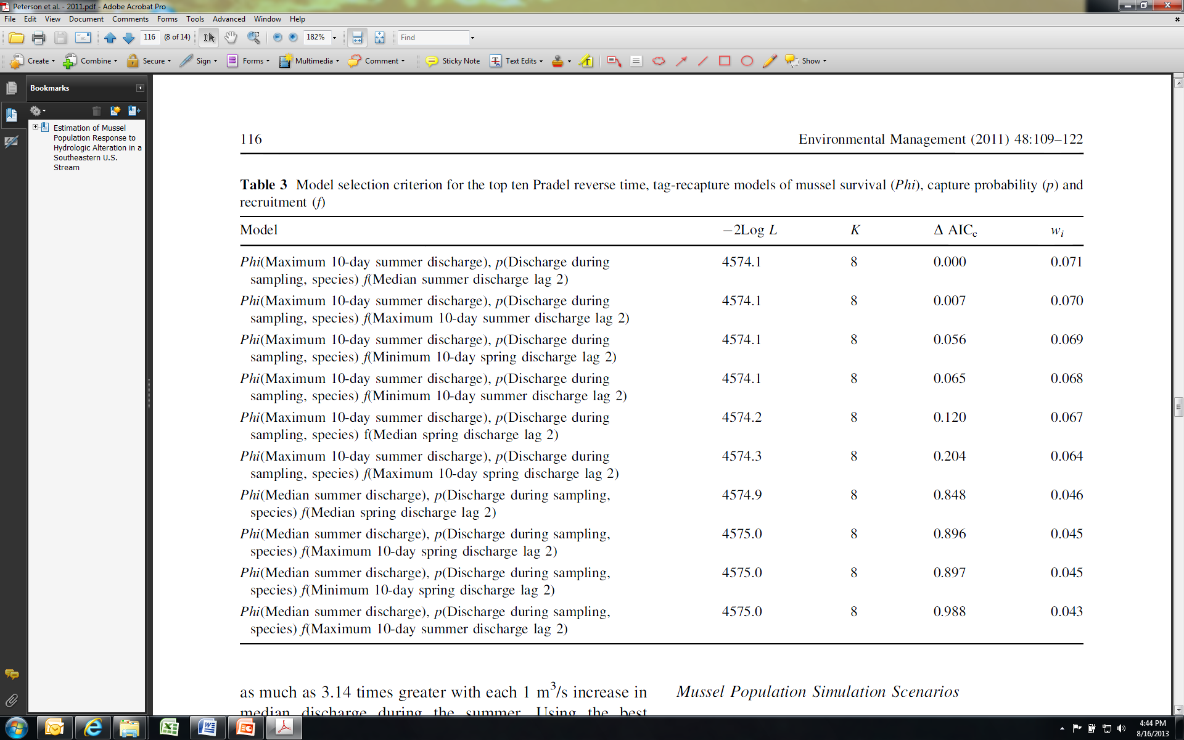
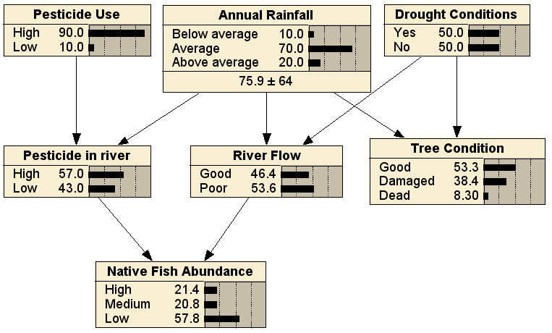
Statistical Models
Analysis of datasets to determine distributional properties of the data
Notes:
Regression
Multi-model
Bayesian
Probability

Slide 19
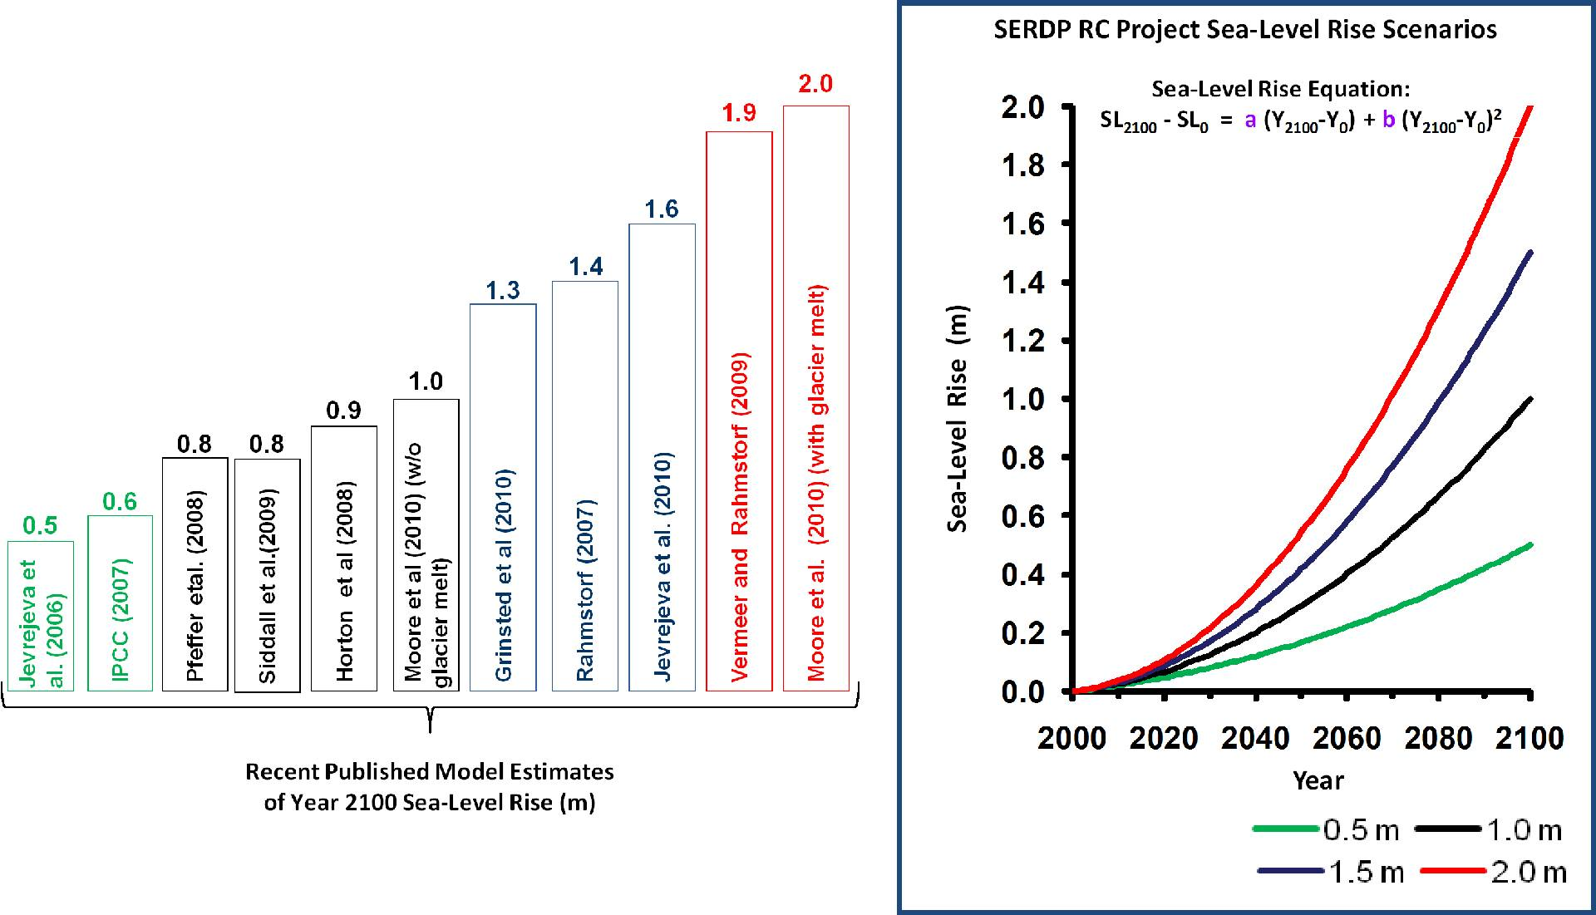
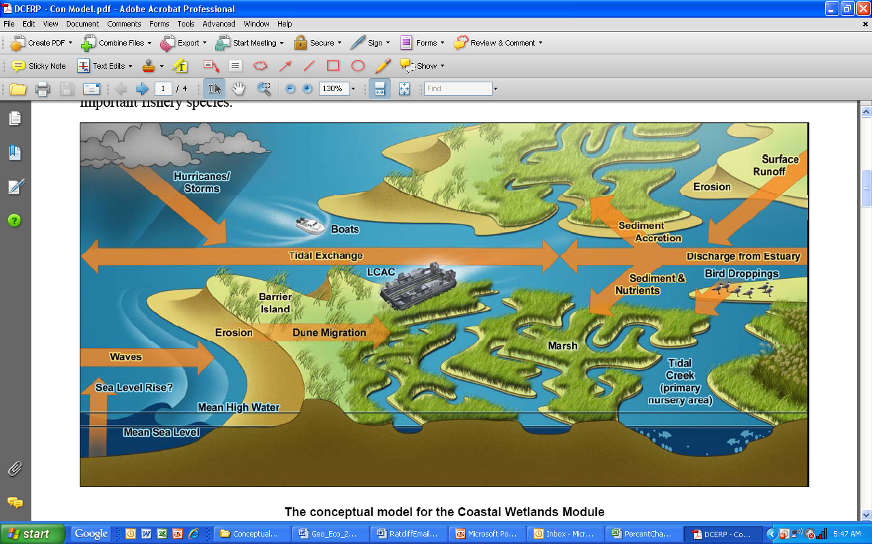
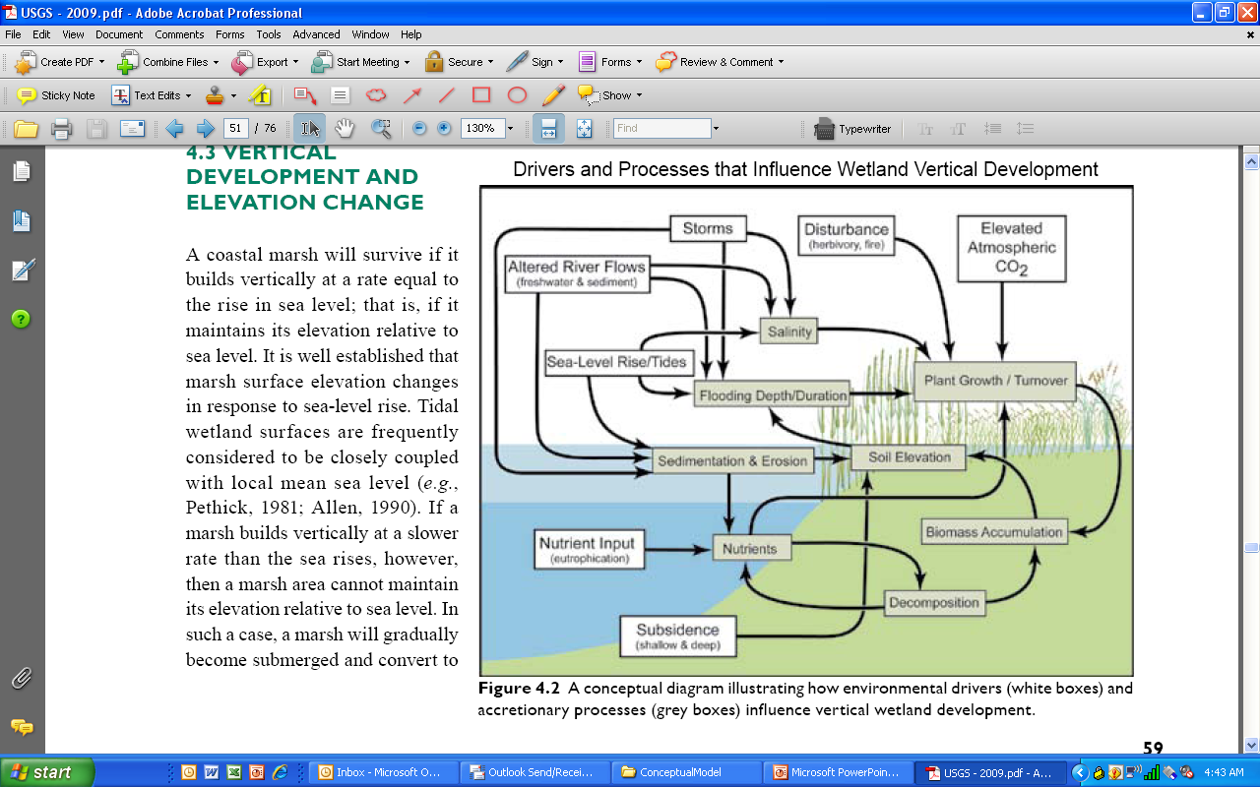
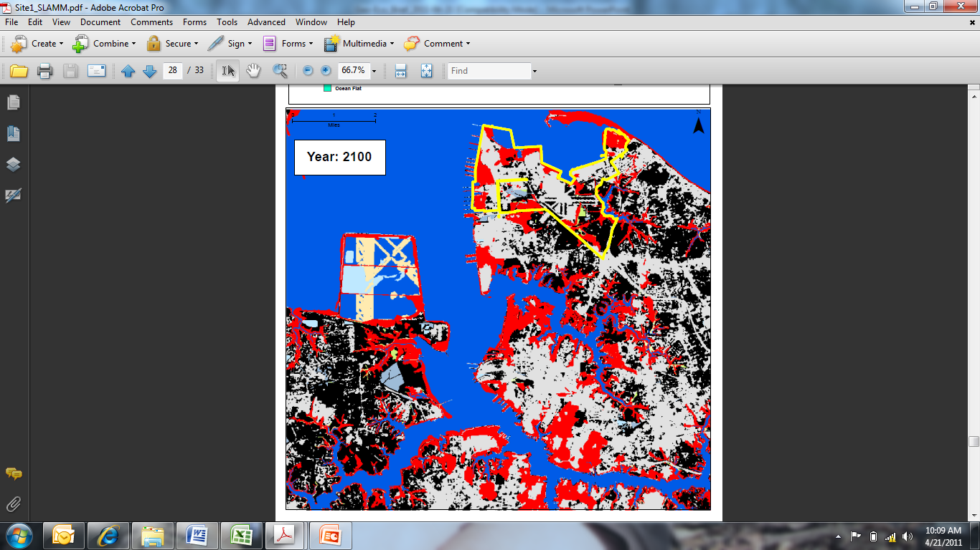
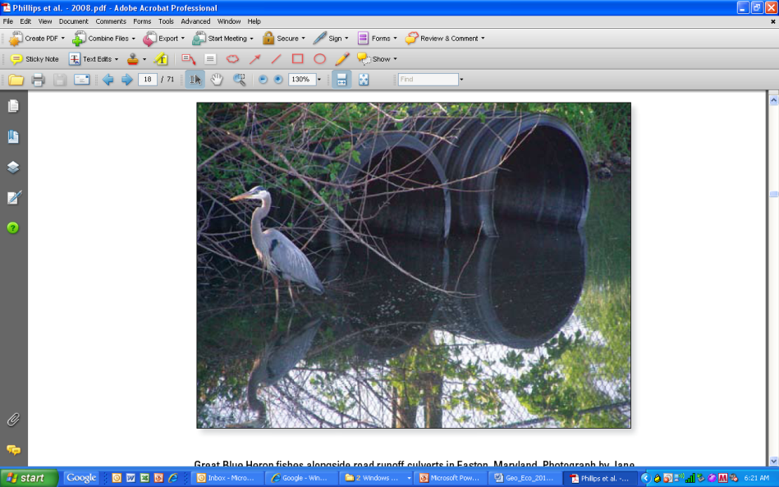
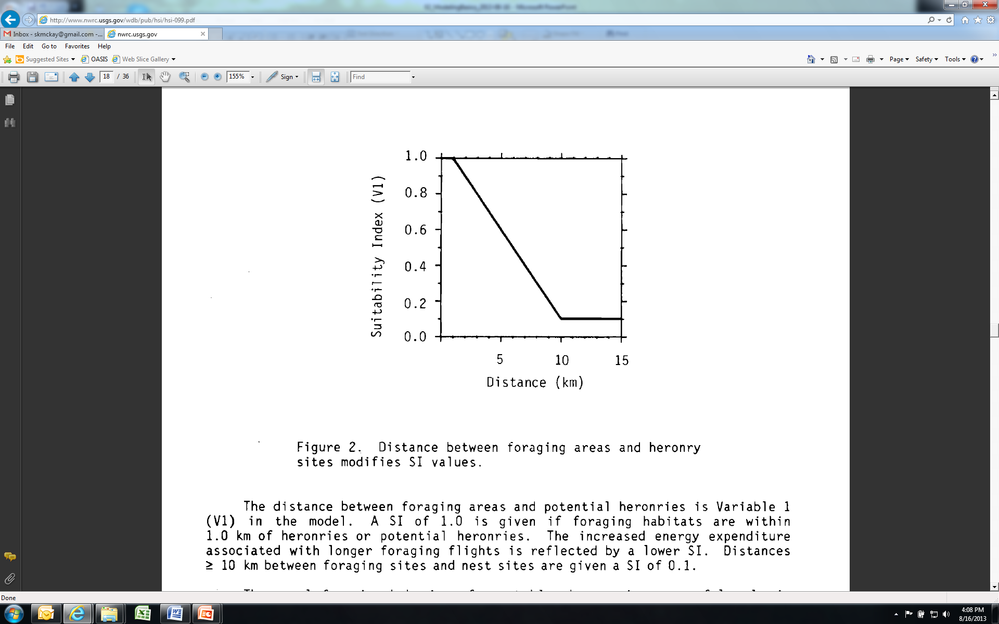
Integrated Modeling

Slide 20
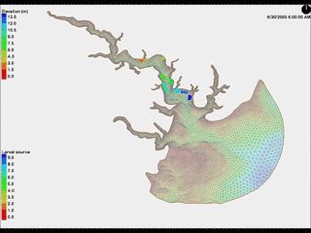
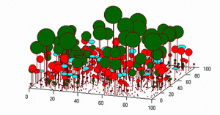
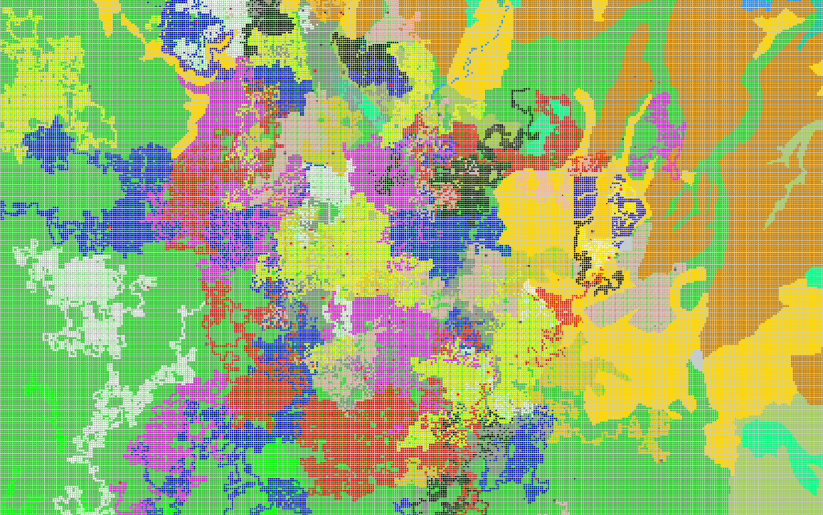
Agent-based Models
Tries to mimic real system by capturing complexity. Builds on concepts of individual interactions creating emergent system properties.
Characteristics
Unique agents are autonomous and interact with others and their environment
System-level properties emerge from low-level behaviors
Different from each other & independent
Model across levels!
Species-Species
Species-Environment

Slide 21
Conceptual Overview
Landscape/Animals
Population Dynamics
Dispersal
System
Level
Animal
Natality
Water
Mortality
Habitat Cells
Water
Hab. Quality
# of Ind.
Etc…
Individuals
Gender
Life Stage
Location
Etc…
Individual
Level

Slide 22

Emergence
Arising of novel and coherent structures, patterns and properties though interaction of elements
Can’t be deduced from the properties of the elements
Pattern can feedback on individuals…across level models!
Example
Imagine a system of arrows where each faces the same direction along a defined radius of a circle
Assign 1 rule: Each second move forward 0.35 units and then turn right 1°. What will happen?
Change the behavior and have them move 0.5 units. What will happen?
Notes:
Run model

Slide 23
Why Agent-based Models?
Agent-based models are computationally expensive, require some programming skills, and a completely novel way to analyze them.
So why would we use them?
We think of the world more complexly and consider interactions
Can explore what happens to systems because of individuals, and to individuals because of systems (feedbacks and thresholds)
Can use rules instead of equations to explain phenomena (e.g, don’t have to know differential equations). Language is much closer to natural language.
Enables analysis of big data and integrated approaches.
Notes:
Ecologists are perfect for agent-based modeling. Our job is to study interactions and spend time getting frustrated when nature doesn’t do what we want.

Slide 24
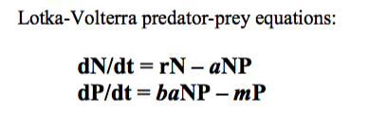
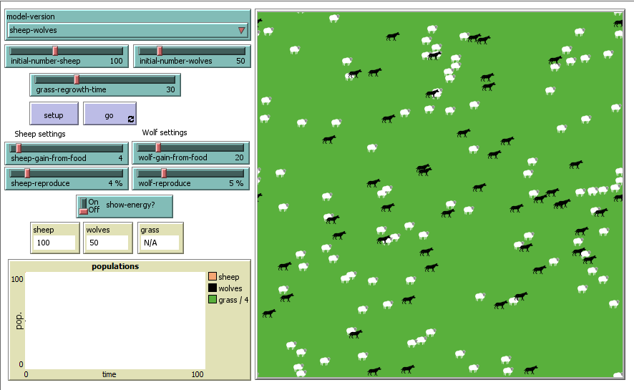
Predator-prey example
Agent-based model
Notes:
Run Model

Slide 25
Let’s get to modeling: Intro to Netlogo
Netlogo
Agent-based modeling platform (designed by Uri Wilensky at Northwestern), based on
Spatially explicit by nature
Open-source and extendable
Low threshold designed to narrow gap between modeler and programmer
High ceiling—models can be scientific enough to be published in literature.
Notes:
Ecologists are perfect for agent-based modeling. Our job is to study interactions and spend time getting frustrated when nature doesn’t do what we want.

Slide 26
Think About | Ask Yourself
Purpose / Objectives | Why are you developing a model (understanding, forecasting, informing, etc.)? What are you trying to accomplish with a model? What question is being asked of the model? What is the model simulating?
Fidelity | What level of accuracy is required (exact v. relative comparison)?
Space | Where is the model targeting? What spatial resolution is of interest (none, order of magnitude)?
Time | Is the model simulating time? How long and detailed (order of magnitude)?
Uncertainty | Where are the data gaps? How does uncertainty work with EWN®?
The Big Picture | Are the prior five categories commensurate?
A few thoughts to consider at 10,000 feet before beginning…

Slide 27
When are models (in)appropriate?
Models might help | Don’t waste your time
I don’t understand my system! Examining future trends Playing out scenarios Quantifying trade-offs between alternatives Communicating with stakeholder or decision-makers | I want to predict EXACTLY what is going to happen I want “the answer” Determining value judgments

Slide 28
Common misconceptions
A model cannot be built with incomplete understanding.
Managers make decisions with incomplete information all the time! This should be an added incentive for model-building as a statement of current best understanding.
A model must be as detailed and realistic as possible.
If models are constructed as ‘purposeful representations of reality’, then design the leanest model possible. Identify the variables that make the system behave and join them in the most simple of formal structures. Parsimony is key (i.e., Einstein’s aphorism…as simple as possible, but no simpler)!
Starfield et al. (1997)

Slide 29
The Modeling Process

Slide 30
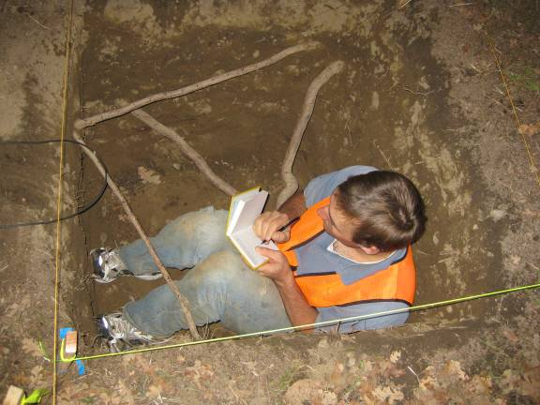
Key attributes for model development teams
Creativity
Flexibility
Quiet
Determination
Humility
Constructive criticism
Listening to local experts!
Develop, refine, collaborate, iterate!

Slide 31
Ecological Model Development
Communication &
Documentation
Conceptualization
Model Users
Colleagues
Team Members
Scientists
Managers
Agencies
Decision-Makers
Stakeholders
Reviewers
Citizens
Grandmothers
Quantification
Iteration
Evaluation
Application

Slide 32
What are conceptual models?

Slide 33
Conceptual Models
Diagramming relationships among components, organizing information, determining data needs, framework for critical thinking

Slide 34
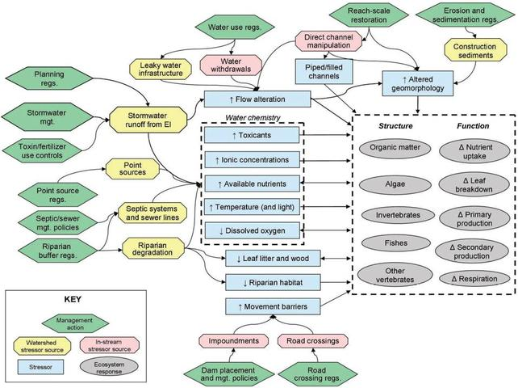
Conceptual models describe general functional relationships among essential ecosystem components. They tell the story of “how the system works.”
Figure: Wenger et al. (2009, JNABS)

Slide 35
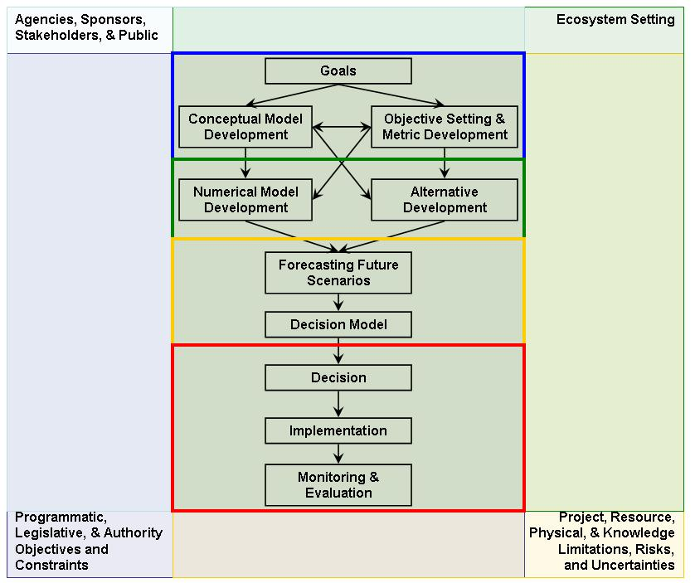
How are conceptual models used in ecosystem restoration?
Communicate the restoration “process”
Synthesize understanding of system function
Understand and diagnose underlying stressors
Develop a common “mental picture”
Identify metrics for project planning, monitoring, and adaptive management
Guide numerical model development
Guide and plan restoration alternatives
Identify R&D needs

Slide 36
How are conceptual models used in ecological model development for Engineering with nature®?
Guide numerical model development
Communicate the project’s “process”
Synthesize understanding of system function
Understand and diagnose underlying stressors
Develop a common “mental picture”
Identify metrics for project planning, monitoring, and adaptive management
Team building
Communication and general understanding
Identify R&D needs

Slide 37
A few stipulations…
The same system can have many potential conceptual models
CMs reflects our personal understanding and viewpoint
Conceptual models are NOT:
The truth – they are simplified depictions of reality
Comprehensive – they focus only upon those parts of an ecosystem deemed relevant while ignoring other important (but not immediately germane) elements
Final – they provide a flexible framework that evolves as understanding of the ecosystem increases

Slide 38
Conceptual Model Development
State the model objectives.
Bound the system of interest.
Identify critical model components within the system of interest.
Articulate the relationships among the components of interest.
Represent the conceptual model.
Describe the expected pattern of model behavior.
Test, review, and revise as needed.

Slide 39
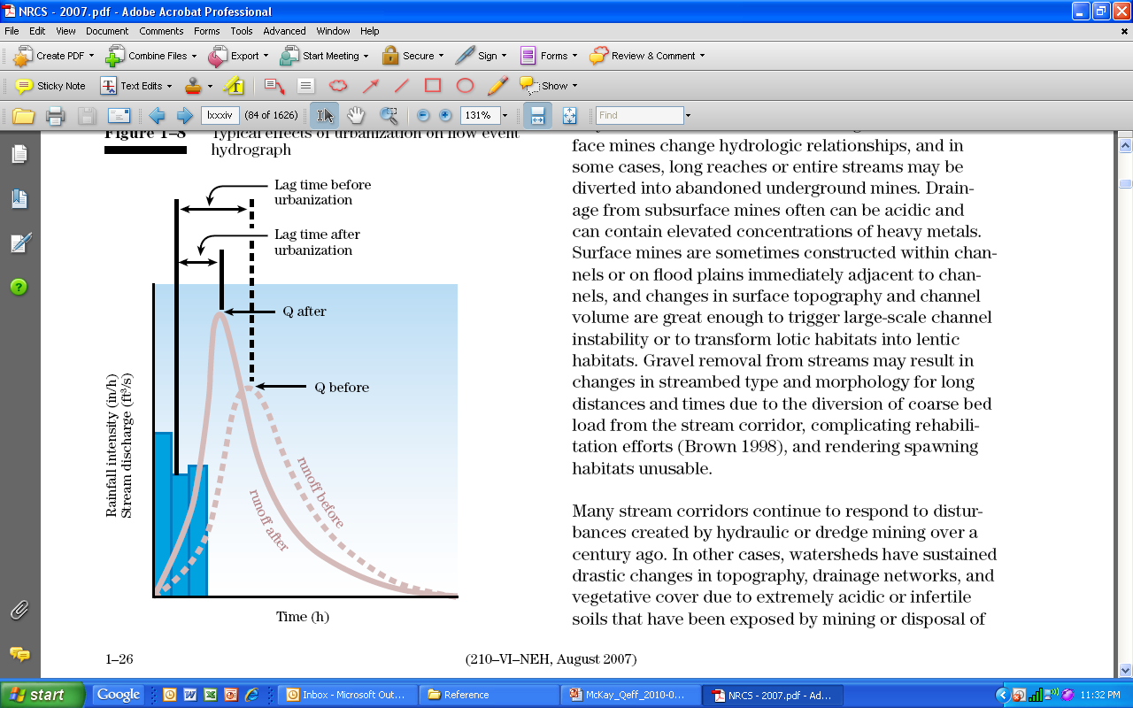
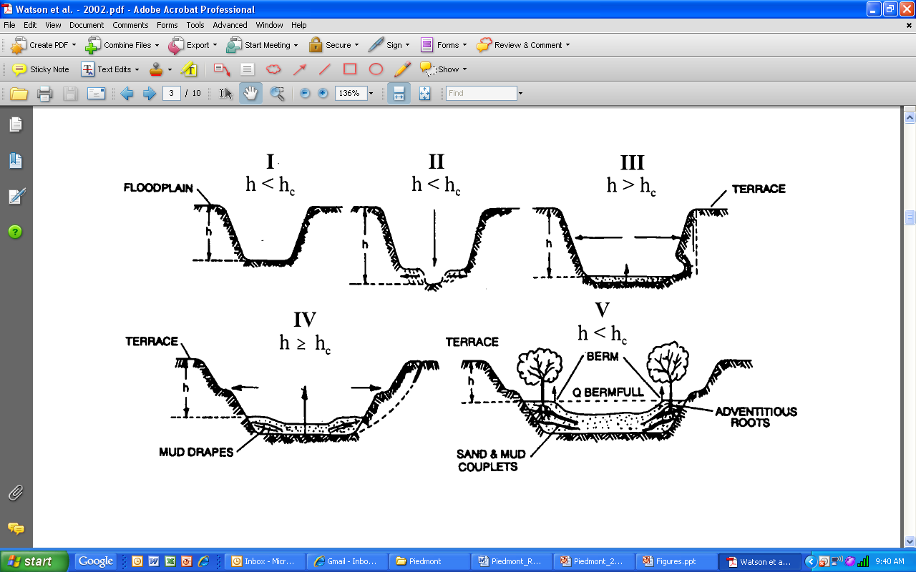
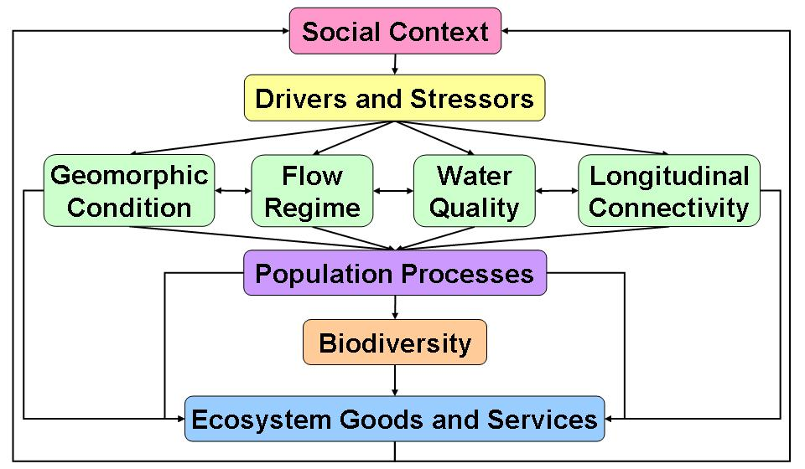
Example: Urban Piedmont Stream
Figure: Schumm (1977), NRCS (2007), McKay et al. (2011), Wenger et al. (2009)

Slide 40
Characteristics of useful conceptual models
Relevant to the problem
Directed at the appropriate spatial and temporal scales
Strike an appropriate balance between over-simplification and over-sophistication.
Underpinned by sound scientific knowledge

Slide 41
Good conceptual ecological models should include:
Those physical, chemical and biological attributes of the system that determine its dynamics.
The mechanisms by which ecosystem drivers, both internal (e.g., flow rates) and external (e.g., climate), cause change with particular emphasis on those aspects of the system where the Corps can effect change.
Critical thresholds of ecological processes and environmental conditions
Discussion of assumptions and gaps in the state of knowledge, especially those that limit the predictability of restoration outcomes.
Identification of current characteristics of the system that may limit the achievement of management outcomes.
Adequate references to substantiate the model.

Slide 42
Reviewing conceptual models (1)
Is it accurately reflecting system function?
Is it effectively presented?
How was the model develop?
Who was involved in development?
Is the model based on scientific evidence (and referenced accordingly)?
Are the certainty and predictability of linkages described?
How will engineering and ecological components interact?

Slide 43
Reviewing conceptual models (2)
Does it appropriately identify the assumptions, limitations, areas of disagreement, and gaps in the state of knowledge?
Will the model’s functionality shift through time (e.g., will processes change with land use or climate)?
Does it sufficiently account for long-term environmental variability and disturbance (e.g., drought, hurricanes)?

Slide 44
Model quantification
Select general quantitative structure
Choose basic time unit
Identify functional forms of the model equations
Estimate parameters of model equations

Slide 45
Quantification
Quantifying models provides ability to understand numerical consequences of ideas, scenarios, system dynamics, etc..
Conceptual Model should be used a template
Equations should be tightly coupled with conceptual model
Helps with communication and transparency
Don’t hide behind the math/code
t

Slide 46
Choosing appropriate mathematics & software
In Theory:
Results should not depend on software or advanced math
What is important is that the critical processes are captured
In Practice:
Software/Mathematics affect efficiency and computation time
Need to identify up-front how model will be quantified
Mechanistic (process-based) models aren’t developed that often for USACE planning
Statistical equations (correlations) used as proxies

Slide 47
Don’t have to be good at math!
Important to recognize differences in training b/w engineering and life sciences
Biologists and ecologists have deep understanding of their systems, but generally aren’t exposed to advanced mathematical techniques
Elegant mathematical solutions are , but they’re not the only approach
If you have an understanding of your system, you can model it

Slide 48
Choosing the time step
Have to choose how often the model is updated, and how long to run it.
We plan for 50 yr horizon, but how often do you need to calculate changes in order to get an accurate idea?
What processes are you interested in? How often do they occur?
Time step needs to reflect what’s happening in nature, not what’s convenient
Don’t have to choose familiar units
Can use 12 seconds, 3 days, 14 months, 50 yrs, etc…

Slide 49
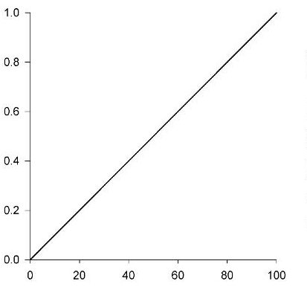
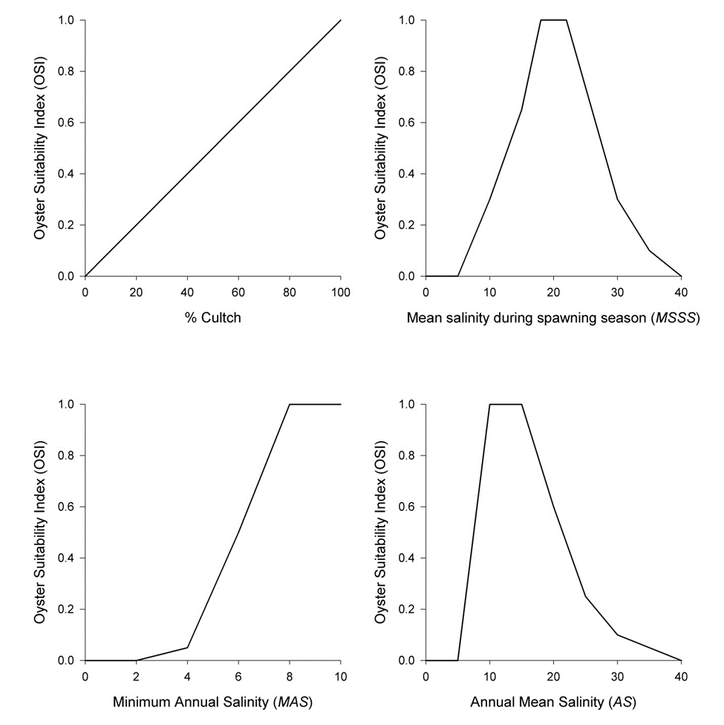
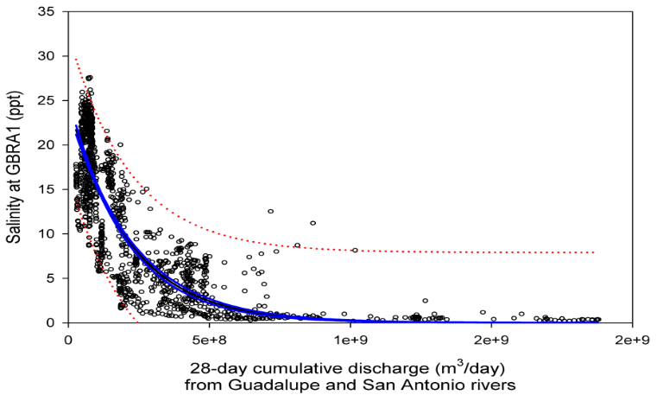
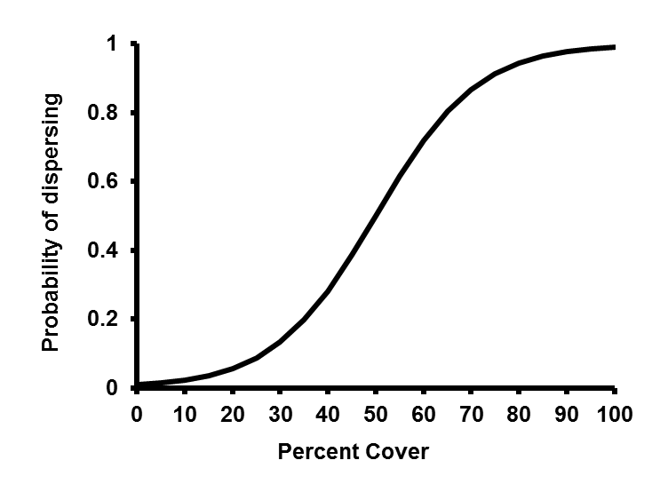
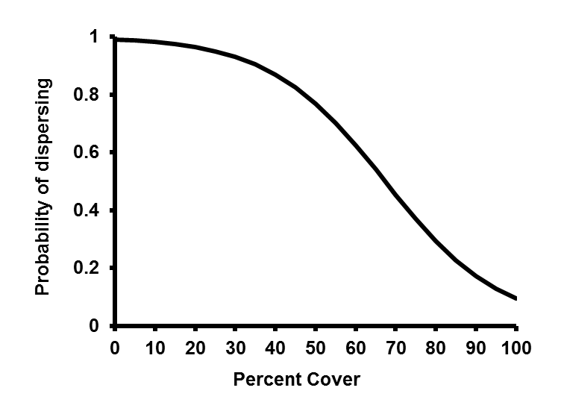


Functional Forms of Equations
How should relationships be quantified?

Slide 50

What if functional forms are unknown?
Use verbal descriptions and graphical functions
Try to explain the relationship in a minute, then draw a picture
Graphical representations provide an intermediate step between verbal and mathematical representations.
Linear functions: simplest relationship; the general relationship between two variables is understood (e.g., variable A increases when variable B decreases), but the exact form is not
Logistic functions: more complex; allows threshold effects, and periods of stasis and rapid change

Slide 51


Types of data and parameterizations
Quantitative Data
Field work
Remotely sensed
Other models
Literature
Theory
Qualitative data
Expert opinion
Hypotheses
The model itself
Experimenting with model can reveal trends and patterns

Slide 52
Capturing feedbacks and thresholds
All environmental systems have feedback (positive/negative) and thresholds
E.g., crowding in populations is a negative feedback
Species viability changes under different environmental conditions
These effects are often difficult to determine precisely in nature

Slide 53

Integrated Models
Using Hydrodynamic Models
Integrated Models are models composed of multiple models
USACE modeling generally combines hydrodynamic and ecological models
Oyster metapopulation used ADH velocity, flow, and WQ data
CH3D temperature, salinity, used as inputs for Oyster Restoration model
SWAT (watershed model) calculated flow, and velocity to determine Zebra mussel larval mortality

Slide 54
Quantifying inputs from hydrodynamic models
Important considerations
What time scale is important to the ecological components of the system?
Hydrodynamic models can run at small time steps that might not be link well with ecological processes.
Cumulative effects are more important (E.g., does seagrass care what happens every 30 seconds, or are exposures over weeks or months more important?
Requires aggregation of Hydro model data to reasonable scales

Slide 55
Quantifying inputs from hydrodynamic models
Are you interested in historical patterns or future patterns?
Does the hydro data contain a range of values that can show wide range of ecological response? If not, inference from eco model limited.
Critical to organize with Hydro modeling team to ensure data will be delivered in appropriate format/scales
Costly and time-consuming to redo simulations

Slide 56

Quantifying Thresholds
Quickest way is with step-functions or if-then statements
Equations are almost never reported if step functions are used
Typical HSI Representation

Slide 57
Missing data
There are often relationships that aren’t defined quantitatively
Have to rely on expert opinion
Literature
Interpolations
This is not less rigorous than quantitative data analysis, just less precise
Qualitative data requires increased attention in the documentation
Will make bigger mistake leaving out important relationships than hypothesizing about relationships
Increased need for transparency

Slide 58
Modeling without data
Decisions will need to be made, regardless of data availability
Need for transparency
Simple functions can help identify magnitude and general trends in absence of data
Expert opinion can be used to parameterize equations until other datasets are available

Slide 59
Spatial Modeling
Incorporating topographic, geomorphic, and/or land use patterns into models to understand how changes in spatial configurations affect ecological dynamics
Space matters
Configuration and composition of landscapes can affect ecological structure and function

Slide 60

http://www.slideshare.net/gceyre/what-is-gis-9719692

Slide 61




Considering Space

Slide 62
Working with spatial models
Considerations:
Location-based differences across the project area
What spatial scale is relevant?
Link ecological processes to a grid/mesh that captures engineering processes
Generally want the grid cell size to be no larger than species can move in one time step

Slide 63

Connectivity
Hydrologic connectivity is the “water-mediated transfer of matter, energy, and/or organisms within or between elements of the hydrologic cycle” (Pringle 2001)
Defining system connectivity
Dimensions: lateral, longitudinal, vertical, and temporal
Biotic vs. abiotic endpoints
Structural vs. functional connectivity
What abiotic regimes influence connectivity (discharge, temp, etc.)?
What ecological processes are connected?
Figure: Wiens (2002)

Slide 64
Model Evaluation
Does your model make sense to someone else?

Slide 65
Steps in Evaluating environmental models
Assess reasonableness of model structure
Assess functional relationships & verify code
Evaluate model behavior vs expected patterns
Does model correspond well to data from real system?
Analyze uncertainty

Slide 66
Evaluation
Process of rigorously assessing model components, structure, parameter values, assumptions, but not scenario results
Commonly called model validation
Models represent a point of view of a system. Validation probably not the best term b/c it indicates a model can be true. Are opinions true?
Evaluation captures the essence of validation without connoting that the model is true
Process needs to ensure scientific defensibility and transparency

Slide 67
Evaluation con’t.
Is the model useful for its intended purpose?
Given the assumptions, structure, and assumptions, can the model be used for what the developers intended.
What are its limits and weaknesses?
Under what conditions does the model break?
Should you try to break it?
Is it re-creatable?
Notes:
Whooping Crane Example

Slide 68
Evaluation is often not Rigorous
Detailed evaluation is rare
Overly rely on software
Don’t have time
Aren’t concerned with recreatability
Discipline hasn’t required it
Small field & modeling was esoteric
But most agencies rely on models now
Increased need for scientifically-defensible and detailed documentation
TRACE (Transparent and comprehensive model evaluation)

Slide 69



Problems with evaluation
Different disciplines have different expectations of model performance

Slide 70

Problems with evaluation
Biggest issue is failure to document entire evaluation process
Iterative approach
Evaluation occurs throughout the modeling process, but is rarely documented thoroughly. Need to document each cycle.

Slide 71



Ecological modeling used for EWN® in practice

Slide 72
Challenges facing planning and executing environmental projects
Reducing risk for large scale, complex projects requires integrated, systems-level approaches (often requiring models to predict potential project outcomes)
Challenges
Ecological models are moving away from expert-based towards modular process-based approaches that can be integrated with other models
Scale, model integration, communication,
Understanding the role of modern ecology in response to disturbance

Slide 73

Scale, Integration, Communication
Persistent Questions center around understanding linkages among physical and ecological processes
What temporal and spatial scales of physical are relevant towards a predictive ecology?
How can we integrate I/O across models?
How can we communicate better to facilitate the integration?

Slide 74


Integrating Eco. Modeling & Remote Sensing
Derive landscape metrics from remote imagery
Develop mathematical model between landscape metrics and suitability
Use model for predictions, and continue to validate and refine data

Slide 75






Infrastructure and fish deterrence assessments/modeling
Modeled fish exposure to sediment plume
Carbon dioxide based fish deterrence design

Slide 76


Natural and Nature-based features
Substantial research on incorporating natural and nature-based features (NNBF) into engineering design
What are the benefits we can derive from incorporating NNBF?

Slide 77

Modeling Coral Resilience

Slide 78




Ecological Modeling for Landscape Change
Identify changes to habitat
Derive landscape metrics
Integrate with ecological simulation
to predict vegetation types, C and N sequestration
Integrate operations tool to create dune and vegetated island features
Calculate potential nutrient sequestration as result of NNBF

Slide 79





How do we model vegetation growth & dune recovery between storms?

Slide 80


Capturing marsh response to episodic sedimentation
Biological vs. construction target elevations
Upper intertidal elevation results in greatest marsh resilience
Elevation relative to the tide changes over time
Marsh Equilibrium Model (MEM) projects future conditions based on known interactions between biomass and accretion
When do consolidation processes switch from being dominated by physical processes (modeled by PSDDF) to biologically-mediated processes?
How to model TLP-induced mortality (proportional to placement thicknesses?
How long does vegetation take to recover

Slide 81

Conclusions & Path Forward
Significant progress has been made in last 15 years on improving ecological modeling practices towards integrated solution
Modeling is headed towards a process-based approach that understands linkages across scales and among models
Research is needed on systems-level approaches centered on within-system interactions (e.g., how different types of NNBF interact with each other)

Slide 82
Acknowledgments
US Army ERDC Integrated Ecological Modeling Team
Drs. Candice Piercy, P.E.; Brook Herman, Safra Altman & Kyle McKay, P.E.
Carra Carrillo & Darixa Abrams-Hernandez

Slide 83
References for Further Reading
Grant W.E. and Swannack T.M. 2008. Ecological modeling: A common-sense approach to theory and practice. Malden, MA: Blackwell Publishing.
Schmolke A., Thorbek P., DeAngelis D.L., and Grimm V. 2010. Ecological models supporting environmental decision making: A strategy for the future. Trends in Ecology and Evolution, 25: 479-486.
Swannack T.M., Fischenich J.C., and Tazik D.J. 2012. Ecological Modeling Guide for Ecosystem Restoration and Management. ERDC/EL TR-12-18, U.S. Army Engineer Research and Development Center, Vicksburg, MS.
McKay S.K. and Pruitt B.A. 2012. An Approach for Developing Regional Environmental Benefits Models. EMRRP-EBA-14, U.S. Army Engineer Research and Development Center, Vicksburg, MS.

